Slide 1
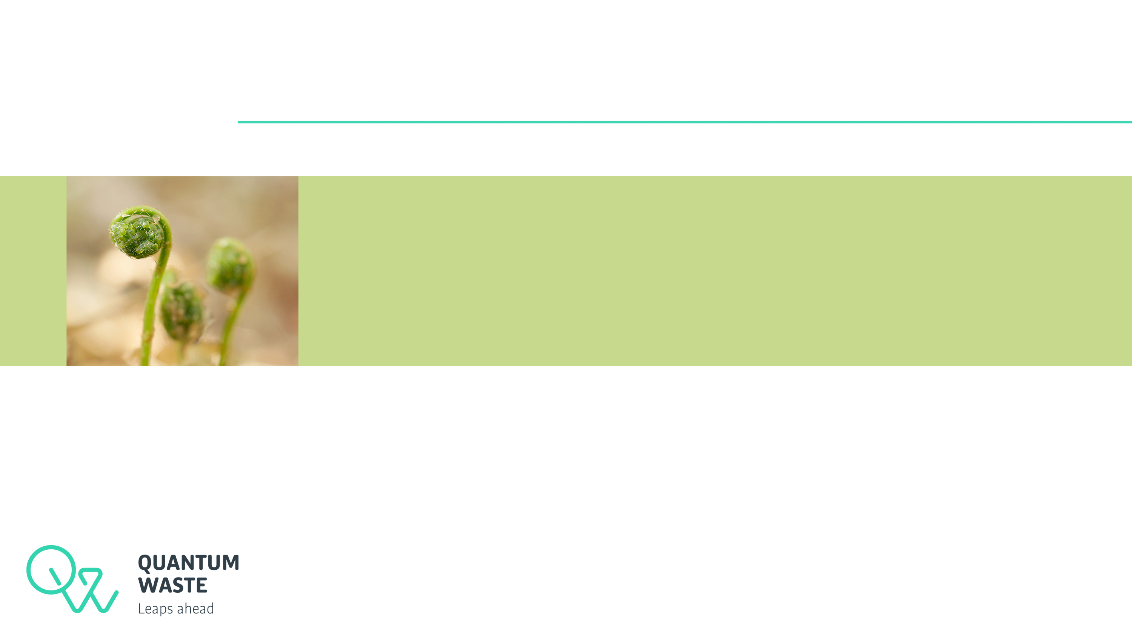
Quantum Waste:
Environmentally and socially responsible waste management solution

Slide 2
Quantum Waste: Introduction
Who we are
  Quantum Waste is a vertically integrated waste management business providing waste collection, sorting and delivery of recovered materials
How we work
  Quantum Waste’s unique approach allows us to collect and process waste locally, minimising transportation time, administrative processes and investment requirements
Our values
  Quantum Waste strives to provide the most sustainable waste management solution
    Socially Sustainable
    Environmentally Sustainable
    Financially Sustainable

Slide 3
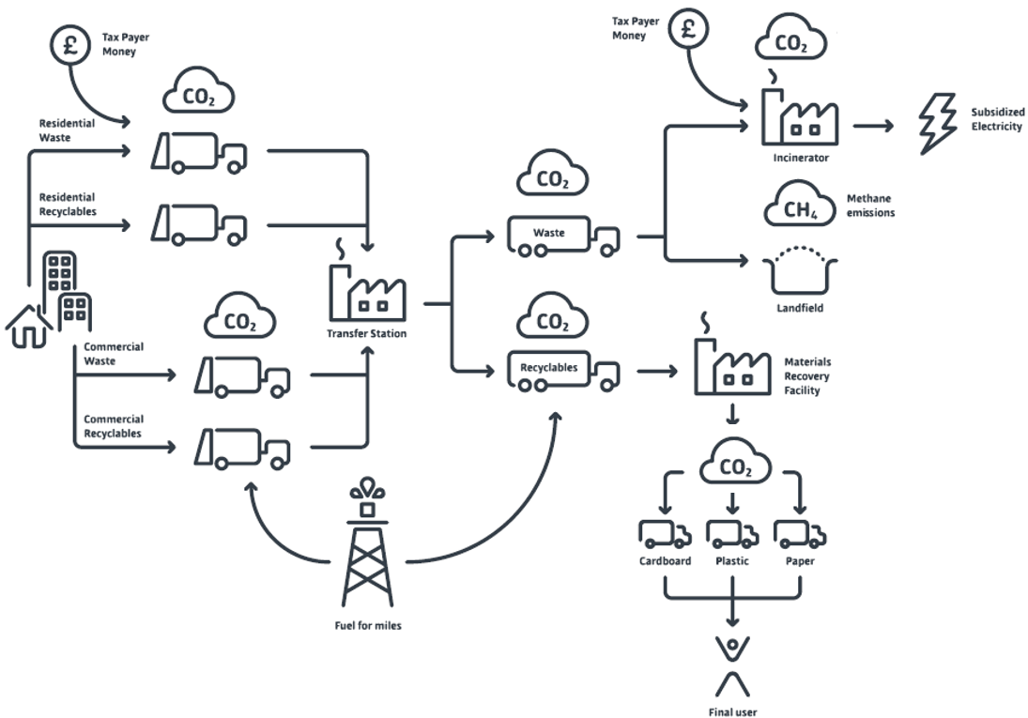
Current waste management model
Complex logistics
High energy consumption

Slide 4
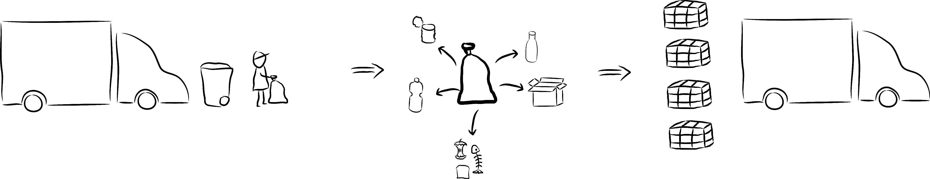
The Quantum Waste approach
One-person three-steps process

Slide 5
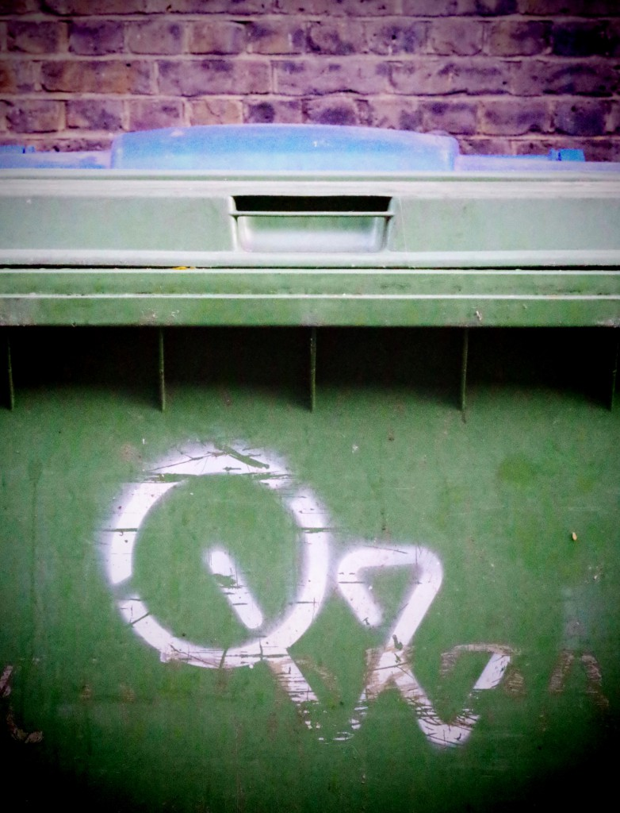
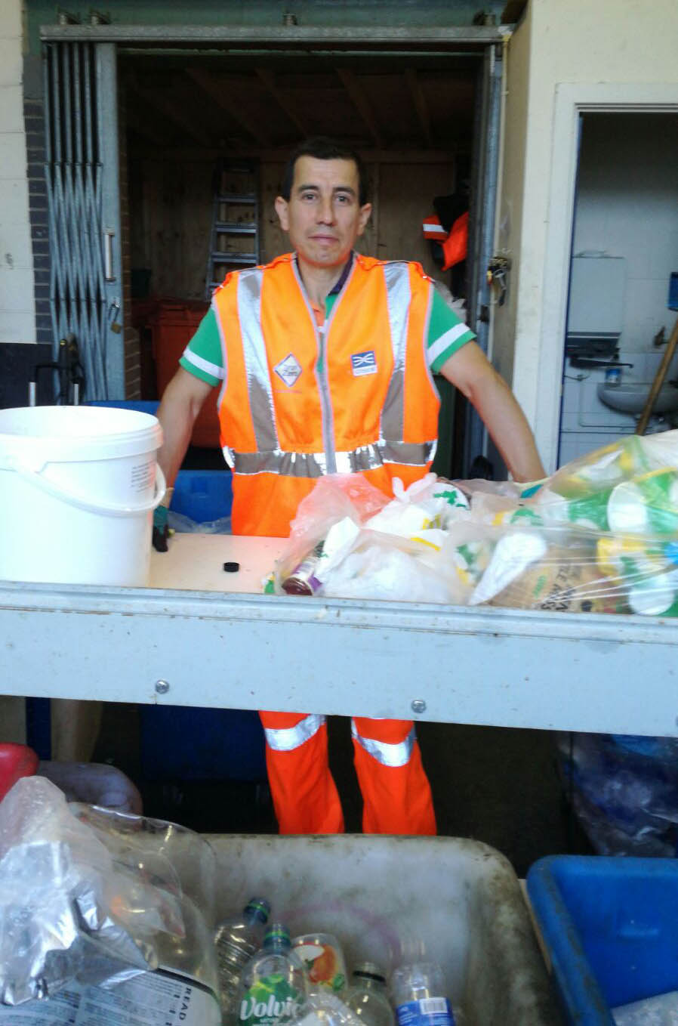
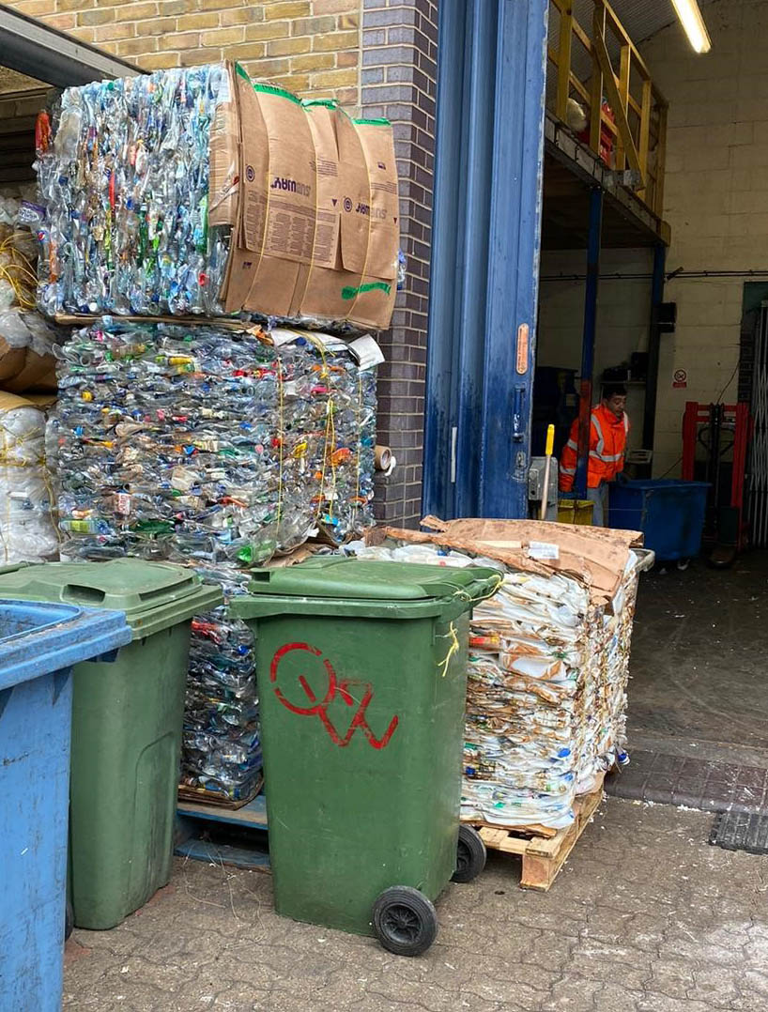
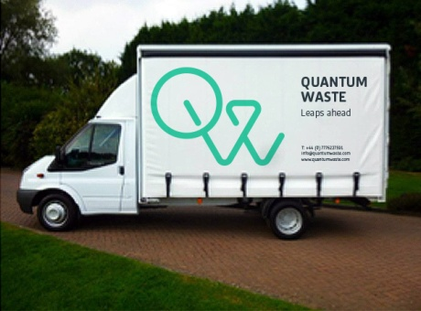
One-person three-steps process
Affordable door-to-door
waste collections
Sorting and baling in a local facility
Delivery of recovered materials

Slide 6
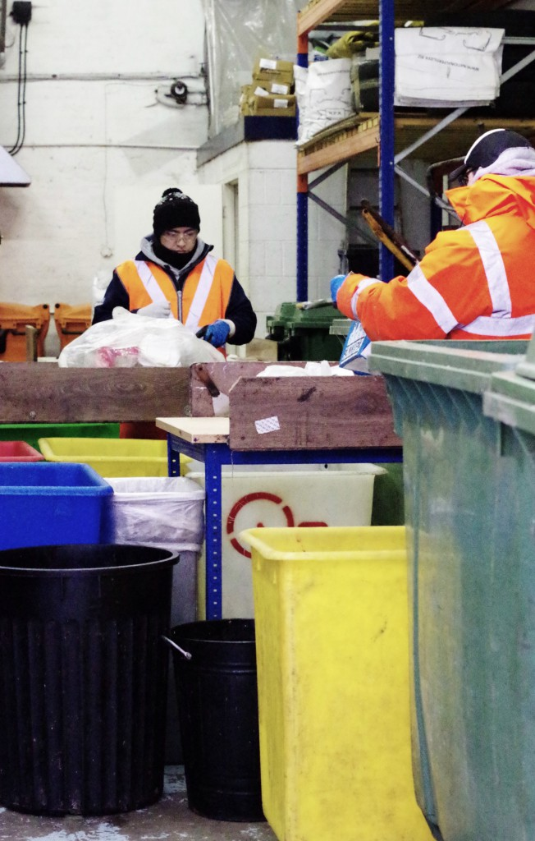
One-person three-steps scheme
Promoting local entrepreneurship and accountability
  Waste collection, sorting and delivery of recovered materials
  completed by one person
  Small scale and personalised service
  Maximum flexibility to suit all customer needs
  Manual waste sorting with high recycling rates
  Rewarding jobs for local people
  Quantum Waste provides customers with feedback and promotes
  best environmental practices

Slide 7
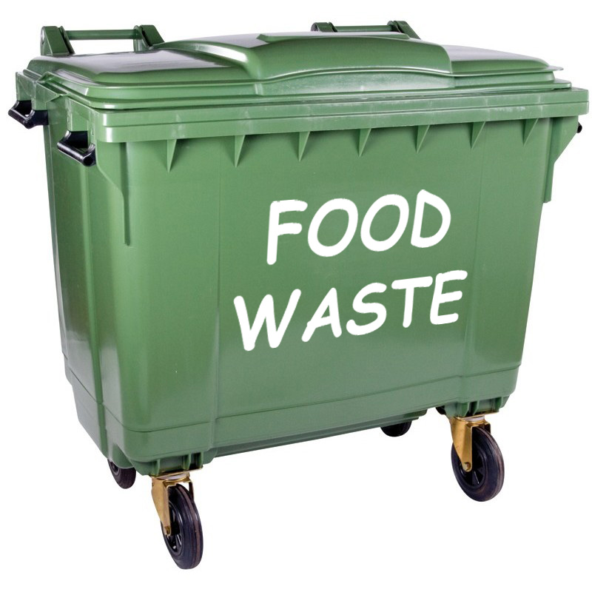
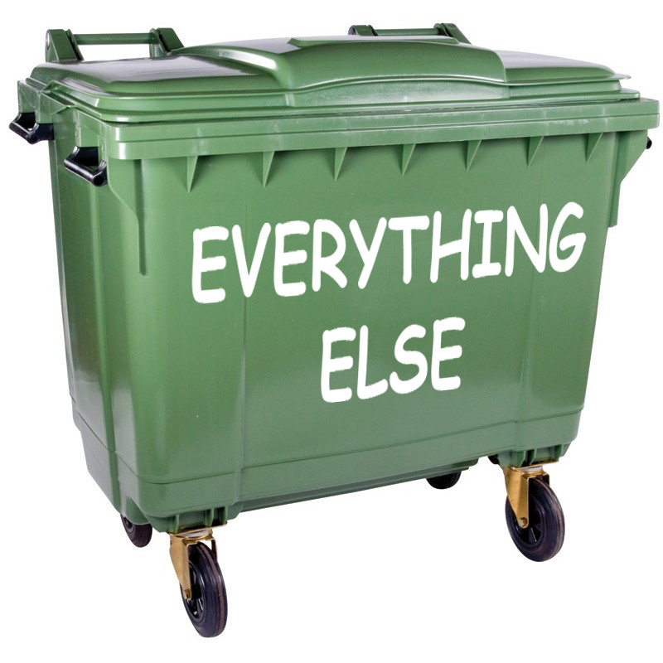
Quantum Waste – only two waste streams
Food waste + Everything else
Just two types of bags ensure a complete recycling scheme
  Waste is collected in smaller vehicles meaning less local disruption and more flexibility
  All waste is collected in transparent bags, making identification of contents easy
  Food waste is diverted from incineration and used to create biogas
  Everything else is manually separated ensuring all recyclable material is recovered
  All bags can be placed in the same container, saving our customers valuable space
  Our flexible and personalised service means that collection of any unusual waste
  (appliances, furniture, garden waste etc.) can be arranged without delay

Slide 8
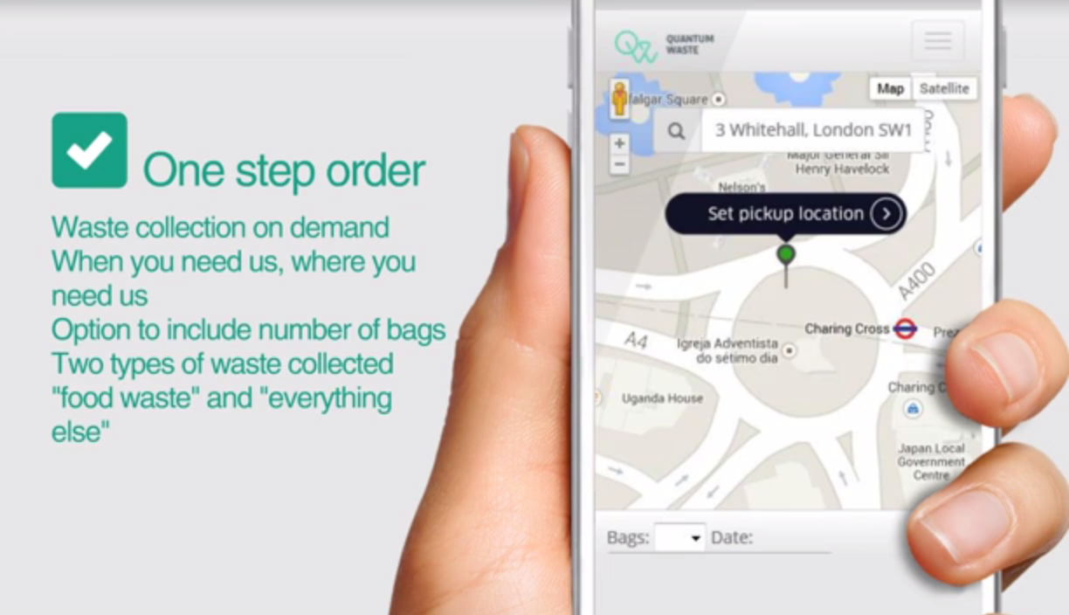
Online booking system for ad-hoc waste collections
The most flexible waste management solution
https://quantumwaste.com/app
As well as serving our regular customers, Quantum Waste offers a unique service for individual waste collections
Our online booking system lets customers book one-off waste collections with just a few clicks
The service is popular with production and event companies who otherwise struggle finding an environmentally friendly solution for their waste

Slide 9
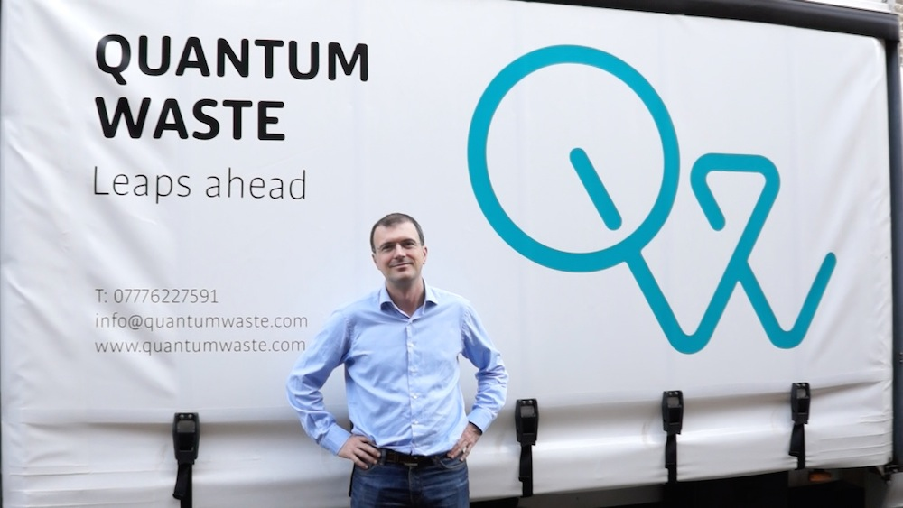
Thank you!
please visit quantumwaste.com
to find out more
or contact us at
info@quantumwaste.com
or 0800 954 9124

Slide 10
What can I put into food waste bags?
Don’t let food waste and biodegradable materials go to waste
Quantum Waste diverts nutrients locked in food waste from incineration and gives them a second life as biogas and fertilizer.
  What can I put into food waste bags?
  All food leftovers, peelings etc.
  Compostable garden waste
  No bags, wrappers or containers
  No compostable packaging (this requires specialised composting processes)
  How to prepare food waste:
  Scrape food leftovers out of containers to maximise the amount of recovered food waste and the quantity and quality of recycled materials
  Place all food waste into transparent bags and tie them well

